Slide 1
Scania decarbonisation questionnaire
How to answer:

Slide 2
NQC | supplierassurance - relevant links
→ SupplierAssurance is the platform on which Scania Decarbonisation Questionnaire is available.
→ NQC is the platform operator / provider.
How to register: supplierassurance - registration
NQC| supplier assurance help pages: supplierassurance - help
NQC Contact portal: Contact Us
NQC Live Chat: Live Chat
NQC phone number: +44 161 413 7983.

Slide 3
1. Once registered and logged in, make sure you navigate to „Dashboard”.

Slide 4
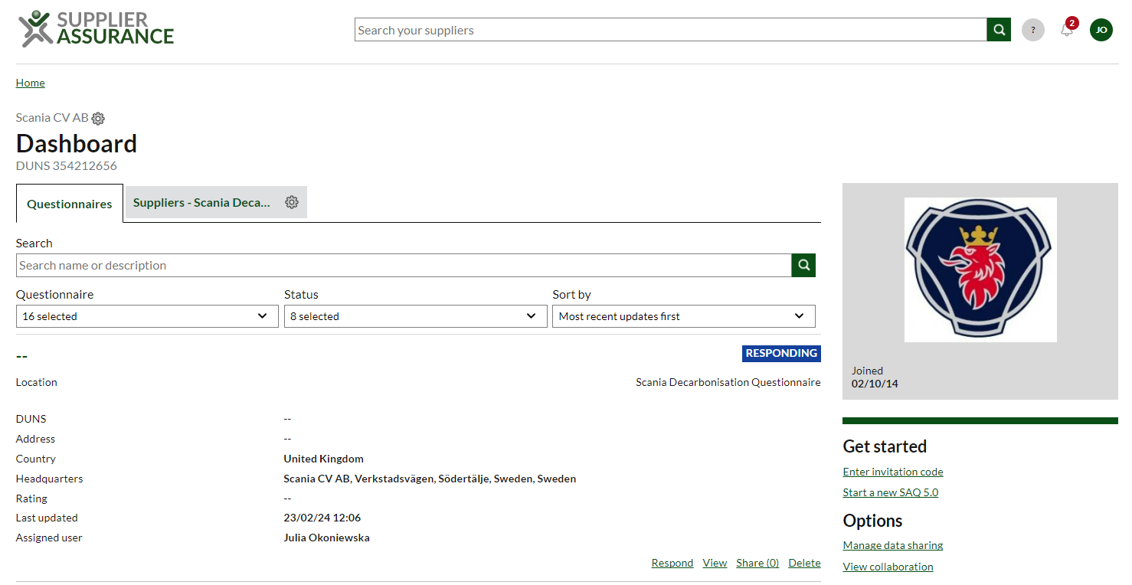
2. In the „Dashboard” view, make sure you choose „Questionnaire” section.
3. Click „Enter invitation code”. Enter the invitation code for Scania Decarbonisation Questionnaire.

Slide 5
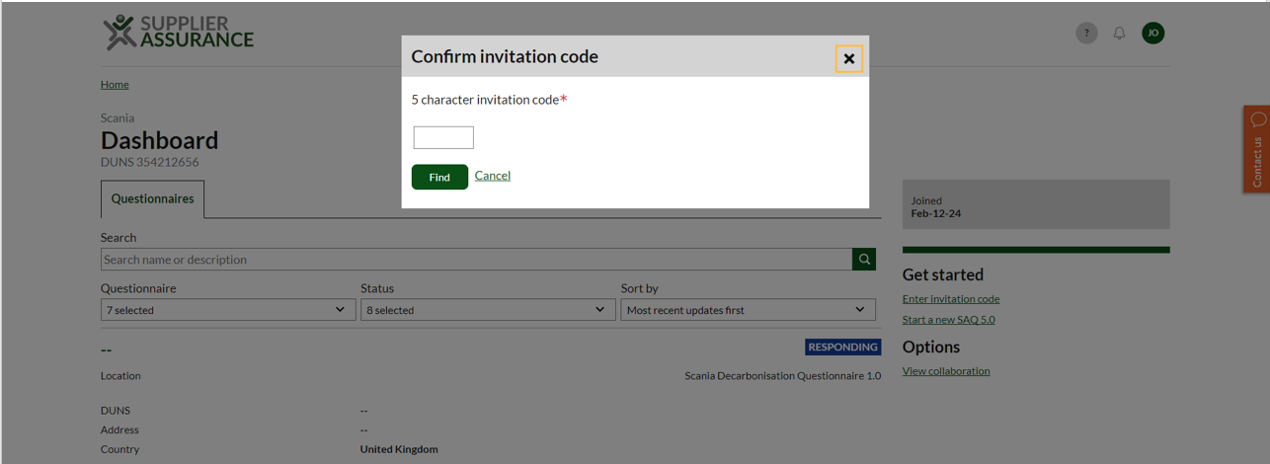
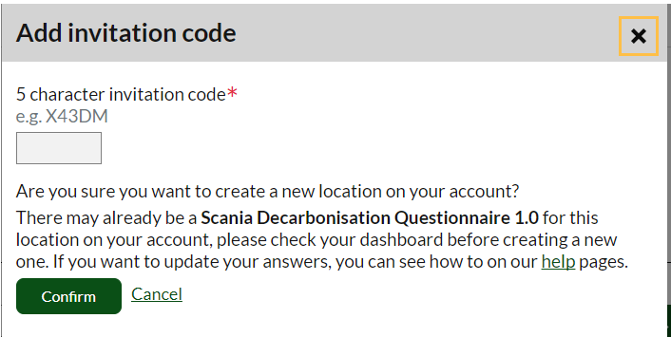
4. Enter the invitation code "23MGA" you received from Scania’s invitation letter. Click „Find”.
5. The next window will request a confirmation on accessing Scania Decarbonisation Questionnaire, click „Confirm”.

Slide 6
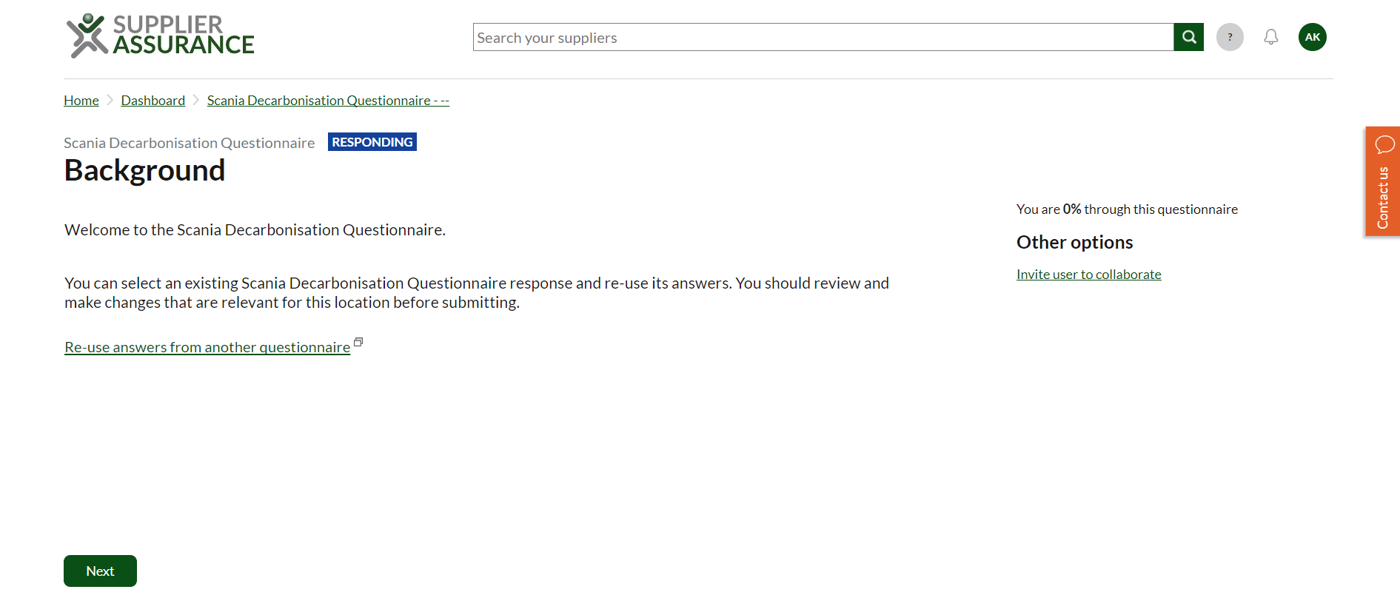
6. You should be able to see the above as the Background to the Scania Decarbonisation Questionnaire. Click „Next” to start the questionnaire.

Slide 7
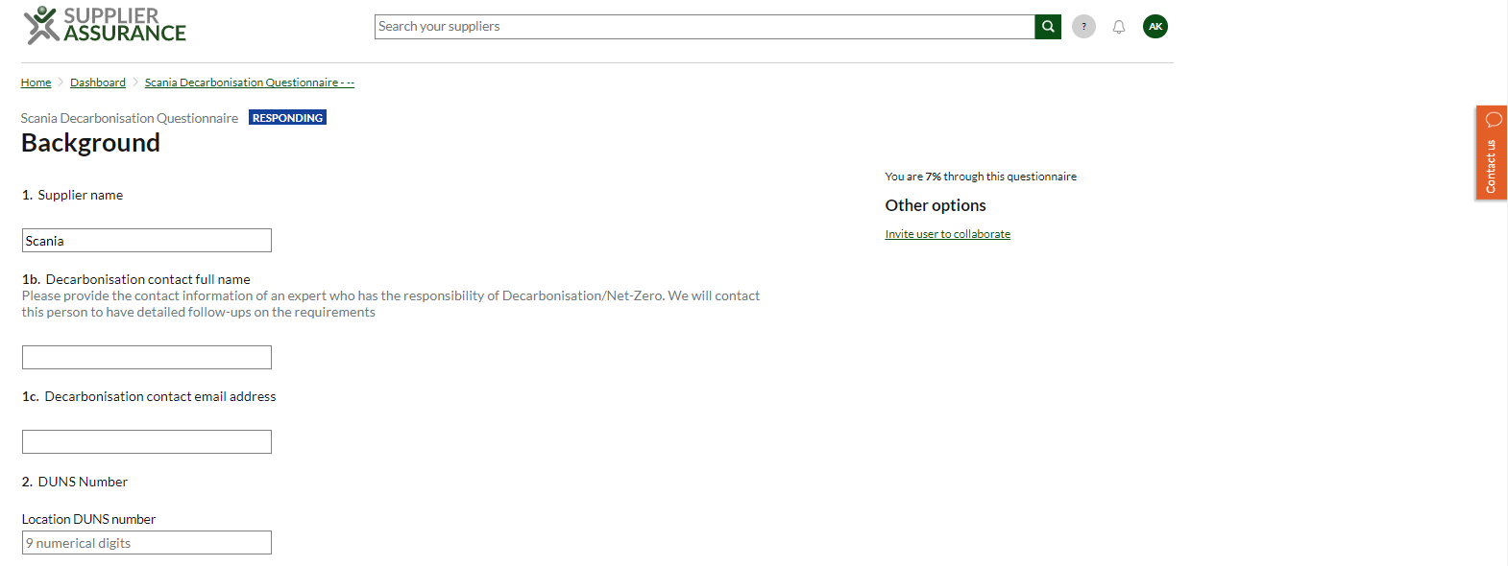
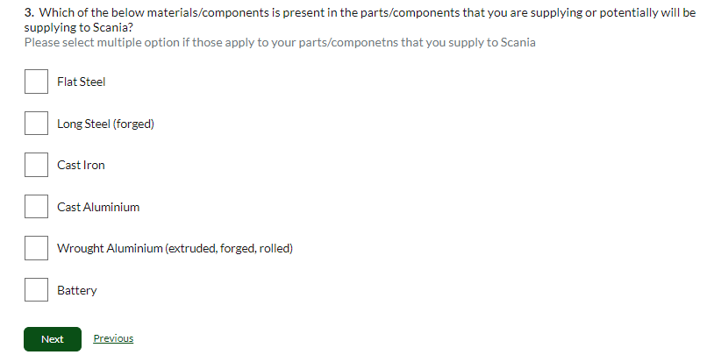
7. Start filling in information about your company and Decarbonisation contact person
8. On the same page, select correct material/components and click „Next” to proceed with the rest of the questionnaire.
(!) If you supply more than 1 material/component, please make sure you choose all the relevant answers here (!)

Slide 8
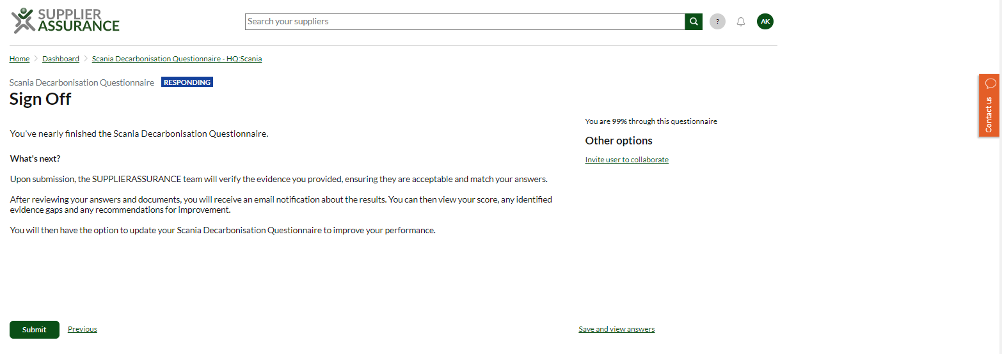
9. Once all your answers are filled in, click „Submit”
10. If there’s a need, you can save and view your answers before submitting them

