Slide 1
“MBD Supplier Assessment” “Driving Innovating Together”
Pieretti welington
revision 00

Slide 2
Introduction
"Welcome to the MBD Supplier Readiness Assessment"
Scania are under constantly transformation to drive the shift towards a sustainable transport system, with that in mind, we are excited to embark on a transformative journey, we started the evaluation together with Scania’s R&D developing and studding the possibility to migrate Scania’s design from 2D drawings to Model Based Definition (MBD). Your collaboration is crucial in driving innovation and excellence.
MBD is a methodology that leverages 3D models as the authoritative source of product information. It replaces conventional 2D drawings. This approach not only streamlines the design process but also ensures accuracy, reduces errors, and enhances collaboration among stakeholders.
"Your Crucial Role in Shaping the Future“
As valued suppliers, you play an integral role in our MBD evaluation. You are going to receive a demonstration part called “X-Shaft” to explore the possibilities in the MBD, also participate in a inquiry that is vital for our collective success.
Why You Are Receiving This Presentation

Slide 3
MBD Demo Part – PDD CONTAINER
"Navigating the MBD Demo Part“
Explore the MBD demo part with this guidance. Learn how to open and analyse the part, extract essential information, and gain insights into the future R&D design through MBD. Clear visuals will guide you through.
Double click on the image or on the PDF icon

Slide 4
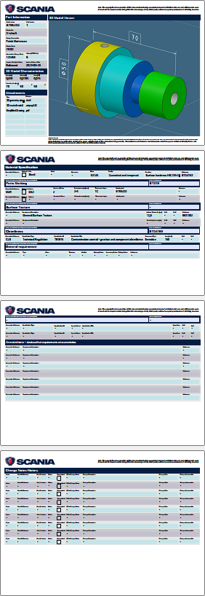
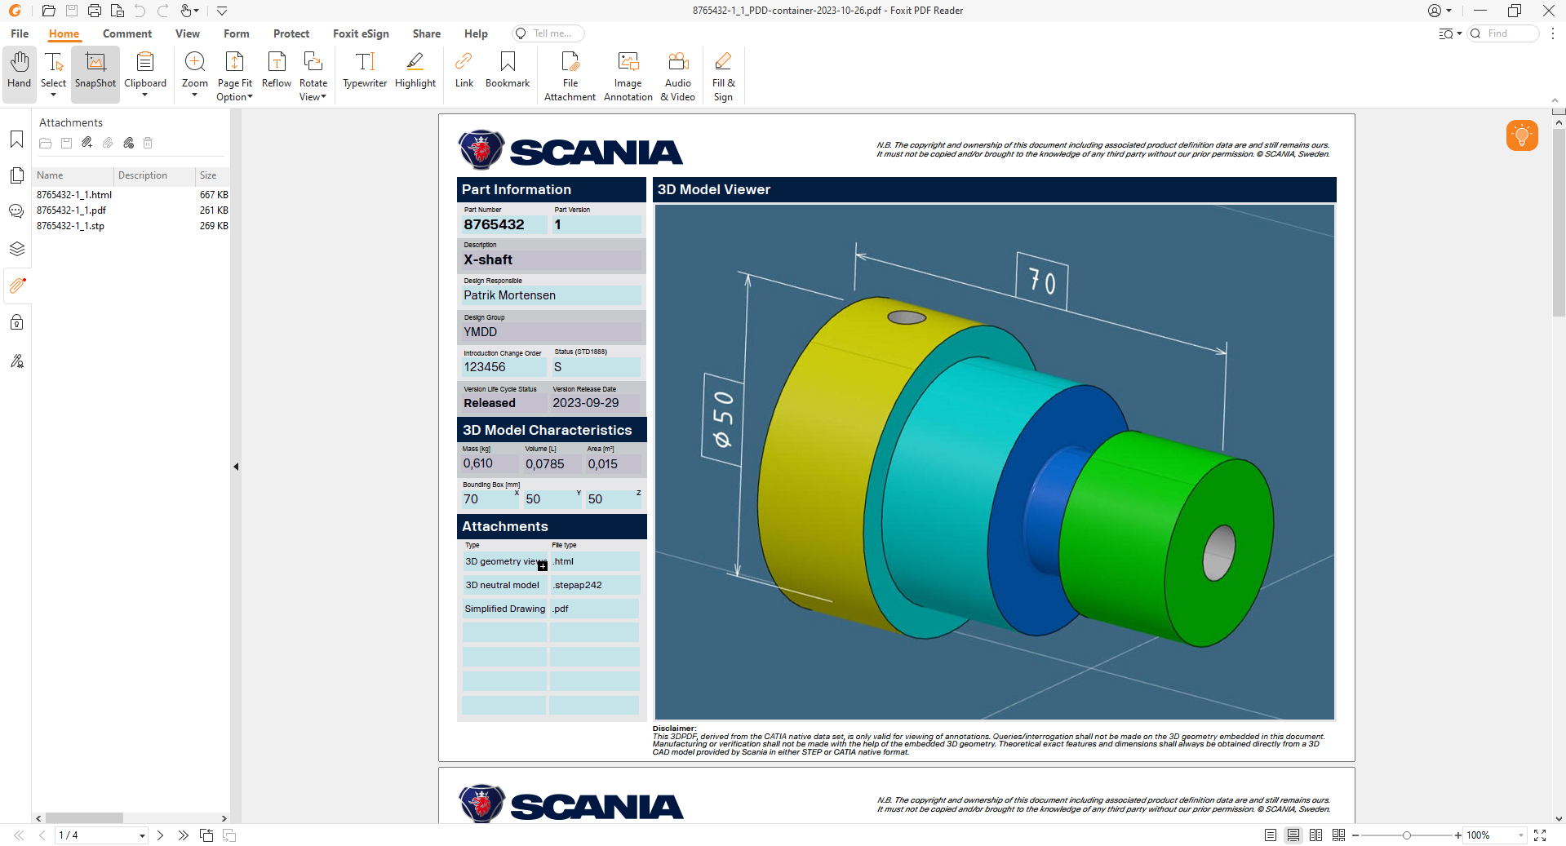
MBD Demo Part – PDD CONTAINER
PDD - Container
PDD Attachments – 3D model + viewer + additional documents when it is needed
Note: Don’t forget to open the attachments tab at the PDF file
MDS – Master data sheet – Part information, 3D Model viewer, 3D model characteristics, material specification, part marking, surface texture, cleanliness, general requirements, unclassified requirements, and part history

Slide 5
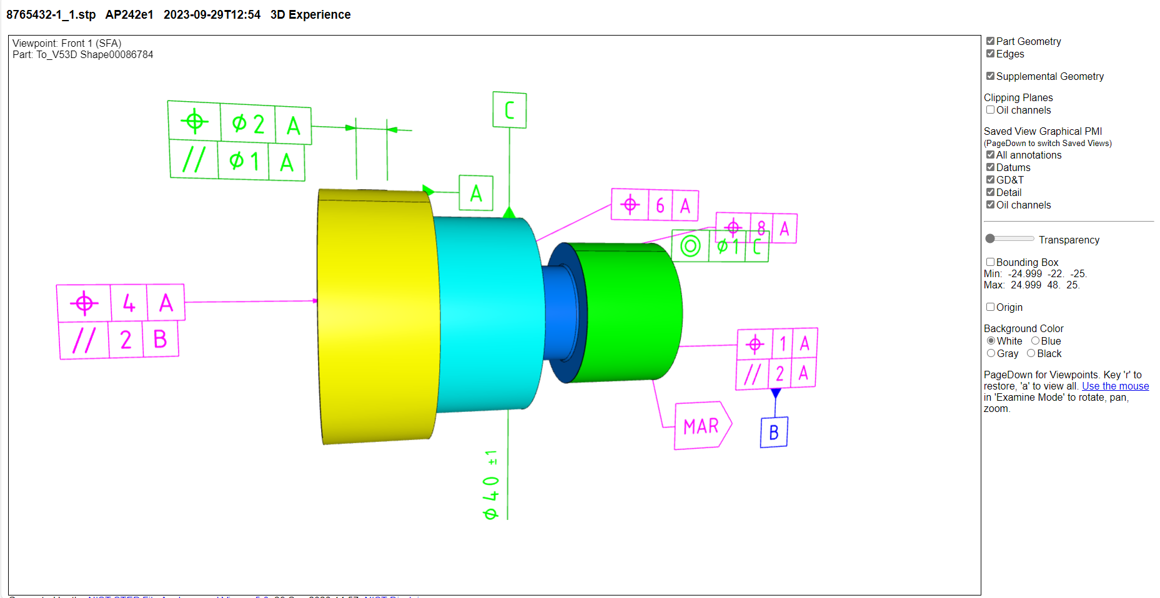
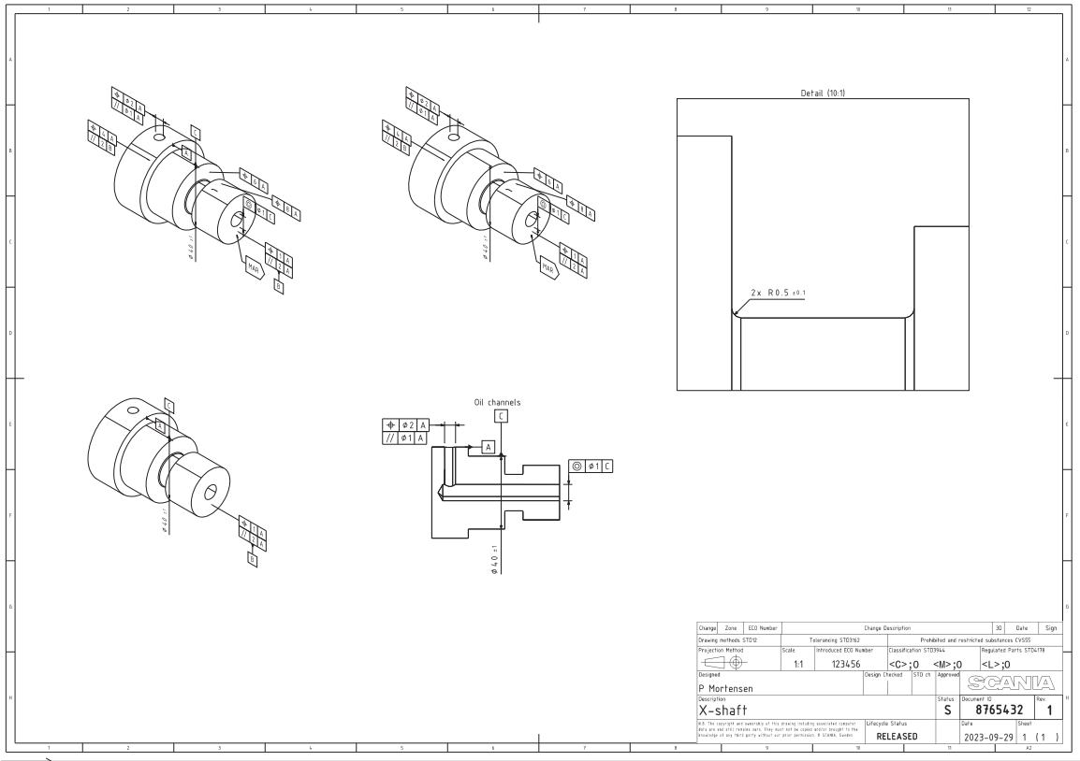
MBD Demo Part – PDD CONTAINER
1
2
1
2
3D Visualisation with some features to help during the evaluation of the part.
Simplified 2D version to be used only in special cases
3
3
We would appreciate it if you could download and assess the 3D model in your software to determine its feasibility for visualizing all characteristics and extracting necessary information. Additionally, please check if it can be opened in your Coordinate Measuring Machine (CMM).
Attachments

Slide 6
"Welcome to the MBD Supplier Readiness Assessment"
We are excited to embark on a transformative journey from 2D to Model Based Definition (MBD) in our R&D design process. Your collaboration is crucial in driving innovation and excellence.
Our Expectations from You
"Key Expectations"
We have high expectations for your valuable feedback. Your honest and detailed responses to the questionnaire will shape our MBD processes. Together, let's set a benchmark for collaboration and innovation.

Slide 7
Questionnaire Link
"MBD Supplier Readiness Questionnaire"
Your participation doesn't end here. Click the link below to access the MBD Supplier Readiness Questionnaire no longer than January 31st. Share your insights after analysing the MBD demo part. Your responses are instrumental in our journey.
https://forms.office.com/e/MiR6YfQuVJ

Slide 8
Thank You
"Thank You for Your Collaboration"
A heartfelt thank you for your time and commitment to this collaborative journey. Your role is indispensable in charting new territories. For any questions or further assistance, please reach out. We look forward to building the future together.
Any question, send an e-mail to welington.binatto.pieretti@scania.com

