Slide 1
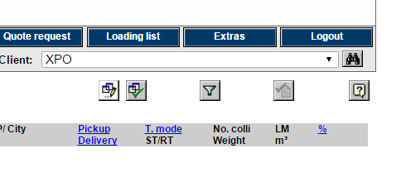
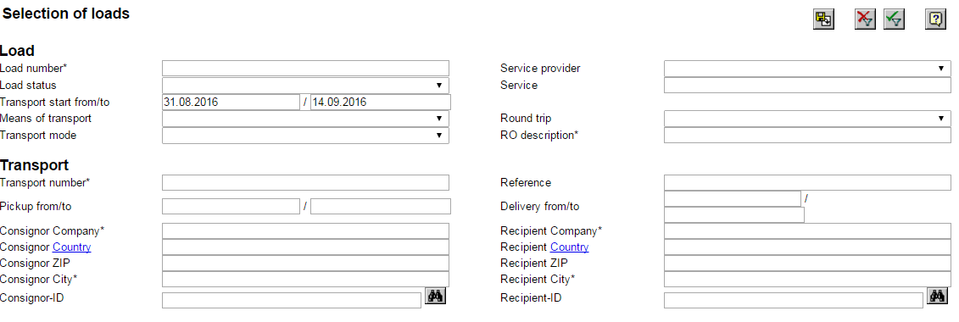
Sort out loads for export or Overview
Steps
1. Login to Carrier client and go to loading list
2. Select the filter button.
Change to relevant dates and data in filter.
3. Press on export button for download excel file Or Execution button for look at load’s in system.

Slide 2
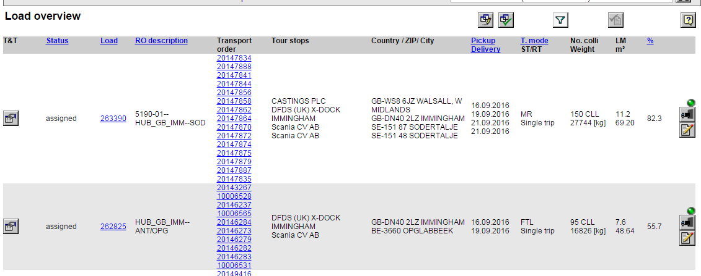
Sort out loads for export or Overview
Open the exported file.
You can now put in relevant filter in order to get an overview for loads on an transport order level(Each line is representing one Transport order, multiple transport orders can be on the same load).
Load Overview
Click on Load number in order to se more detailed information and for adding Trailer plate ID.
Click on Dock booking button in order to see dock booing window with slot times for delivery to Scania location and also Pickup time at X-docks.
Click on Status button in order to add a new status for the load.

Slide 3
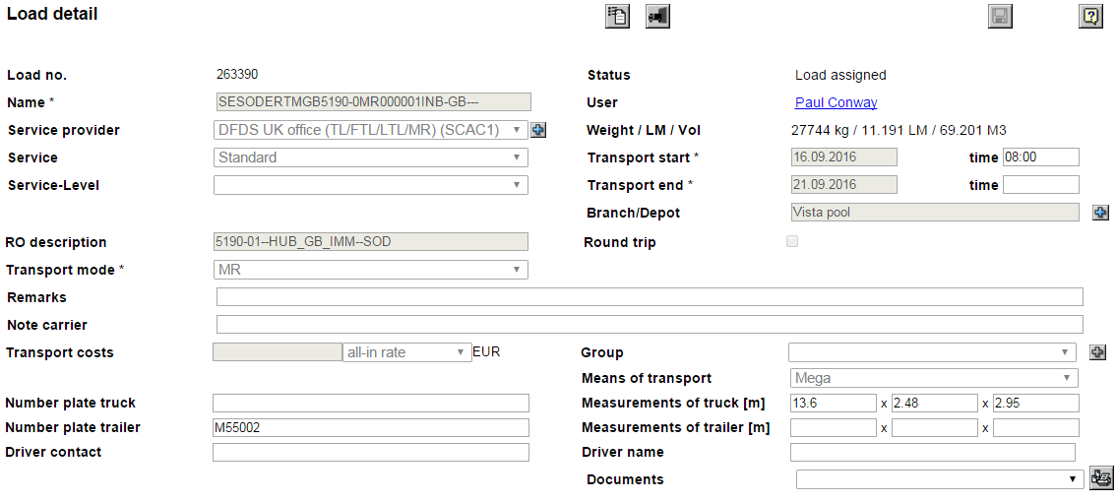
Add Trailer plate ID
Open one of the loads.
In field “Number plate truck” and “Number plate trailer” You can add ID.
When Trailer ID is filled in click on Save botton.

Slide 4
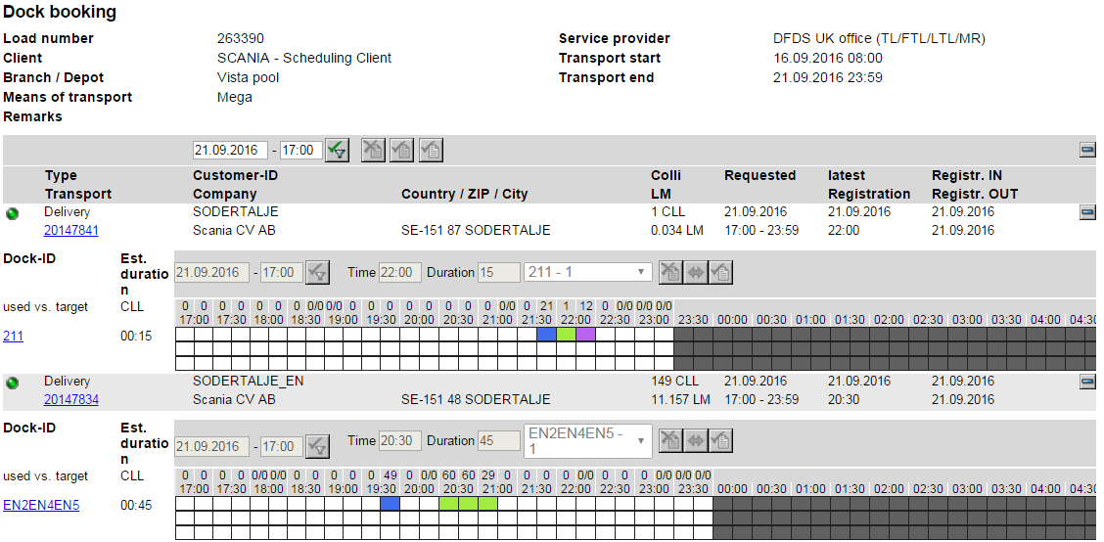
Get slottimes and offloading Sequecns from Dockbooking view
Open Dockbooing window.
Click on expand button
You will now see the Dock IDs in the left part of the view and the registration time in the right side.
In this example:
EN2EN4EN5 will be offloaded first at 20:30
211 will be offloaded last at 22:00

Slide 5
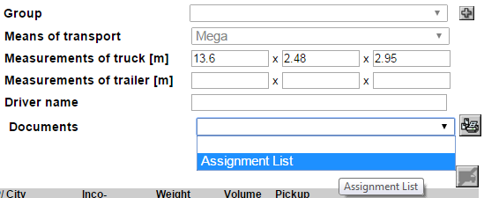
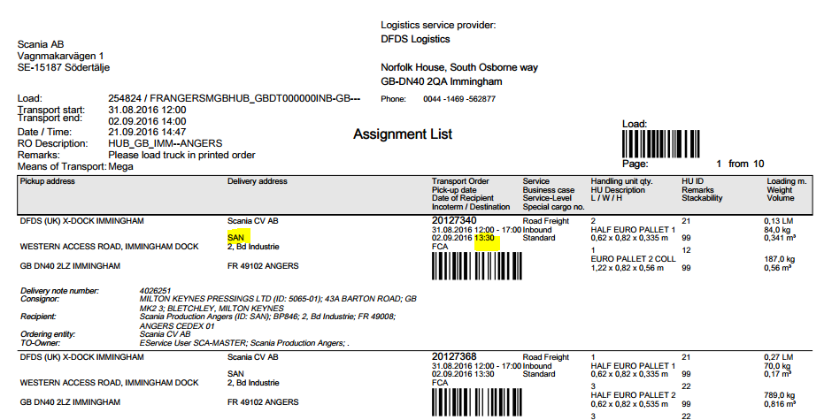
Get slottimes and offloading Sequecns from Assignment list
When have a load open click on scrollbar and select Assigment list and click on Print Button
The printed Assignment list of transport orders are sorted in the Loading order. You can see the highlighted parts with information for dock ID and Slottime.

Slide 6
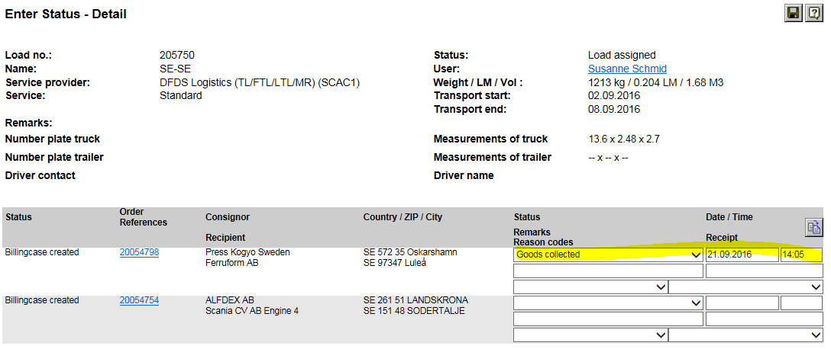
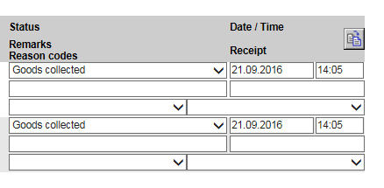
Entering Status for a Load
After entering Status window.
All statuses are added on transport order level, this means that all transport orders need to receive for the load to change status to collected.
You need to fill in at least one Transport order with status, date and time(see highlighted in Yellow).
You can then use the Copy button in order to set the same status on all Transport orders on the load.
After entering the status click on Save button and the status will be updated.

