Slide 1
Quick guide Selfbilling
road-transports

Slide 2



Invoicing process
Time
Supplier
M
T
W
T
F
W.1
Transport
Final billing run
Creates credit note every Friday evening.
It includes finalized transports from the week before. A transport is finalized when goods
reached end-destination:
For inbound (parts): Goods arrived at Scania. Including pre-collection leg
For outbound (packaging): Goods arrived at supplier/packaging pool. Carrier sent delivered
status
Terminals
cross-docks
M
T
W
T
F
W.2
Transport
Invoice
Billing run 1
Transports finished w. 1
Scania production

Slide 3
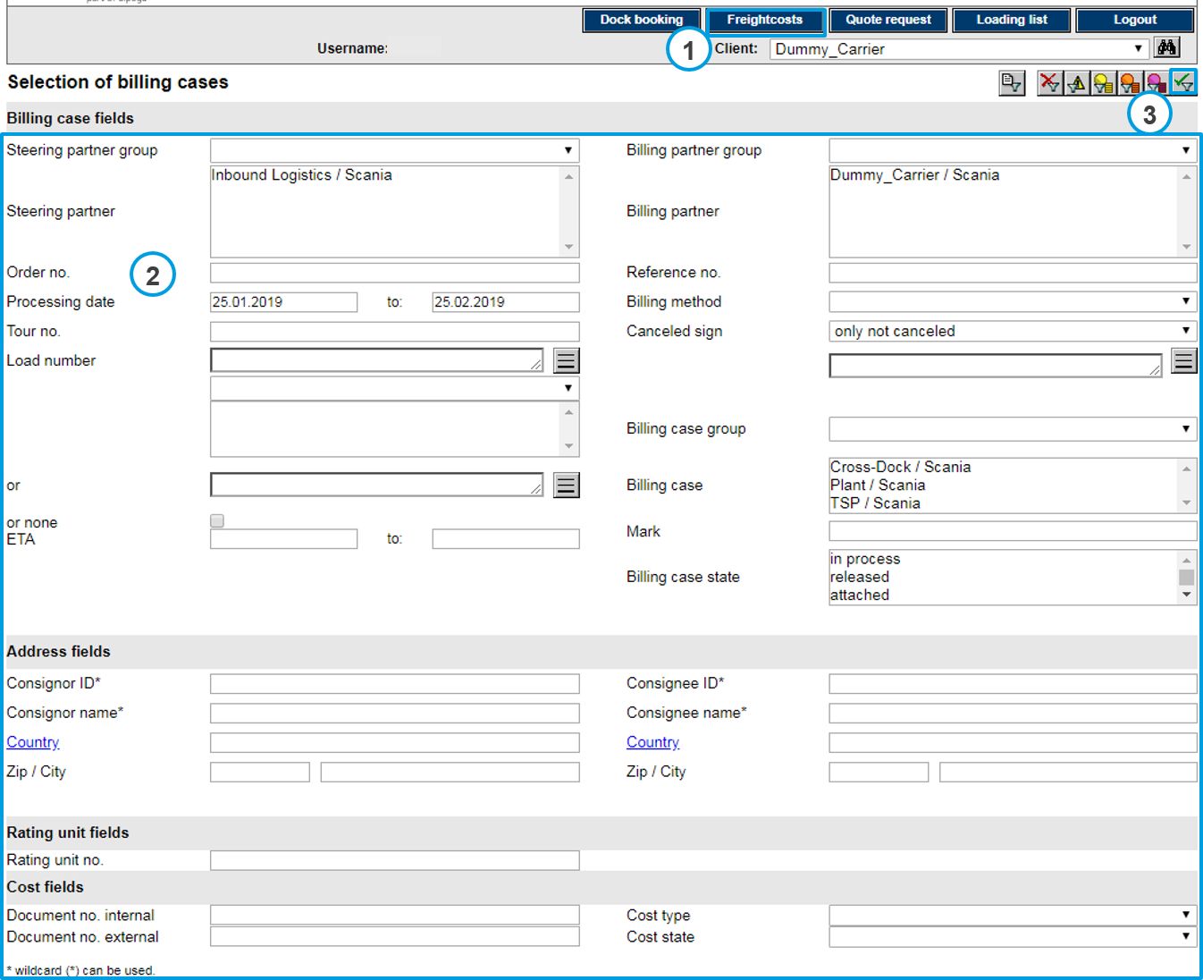
Search for loads in Freightcost tab
To view cost for the shipments and transports, the user must have appropriate rights to use the FM functions.
Open selection of billing cases.
Enter the appropriate filter criteria to search for the relevant shipments and transports.
Execute selection of billing cases

Slide 4
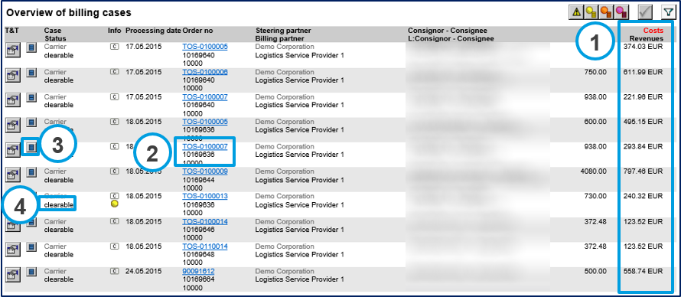
Result of loads in Freightcost tab
Result of the selection are shown in the overview of billing cases.
Total calculated and accepted costs are shown for each billing case.
Open cost details for a single billing case by clicking on the hyperlinked order number.
Alternatively, open the rating unit detail, depending on the actual case.
Billing case status.

Slide 5
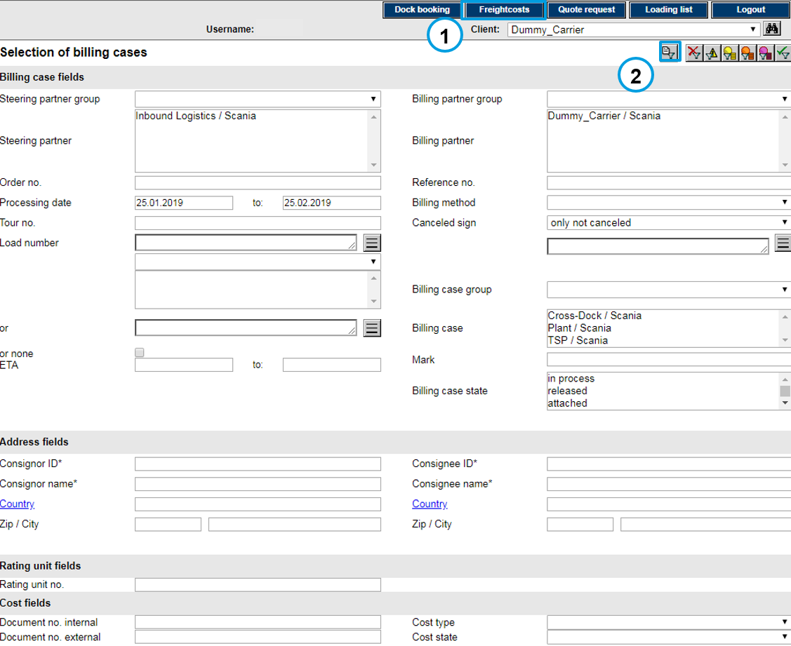
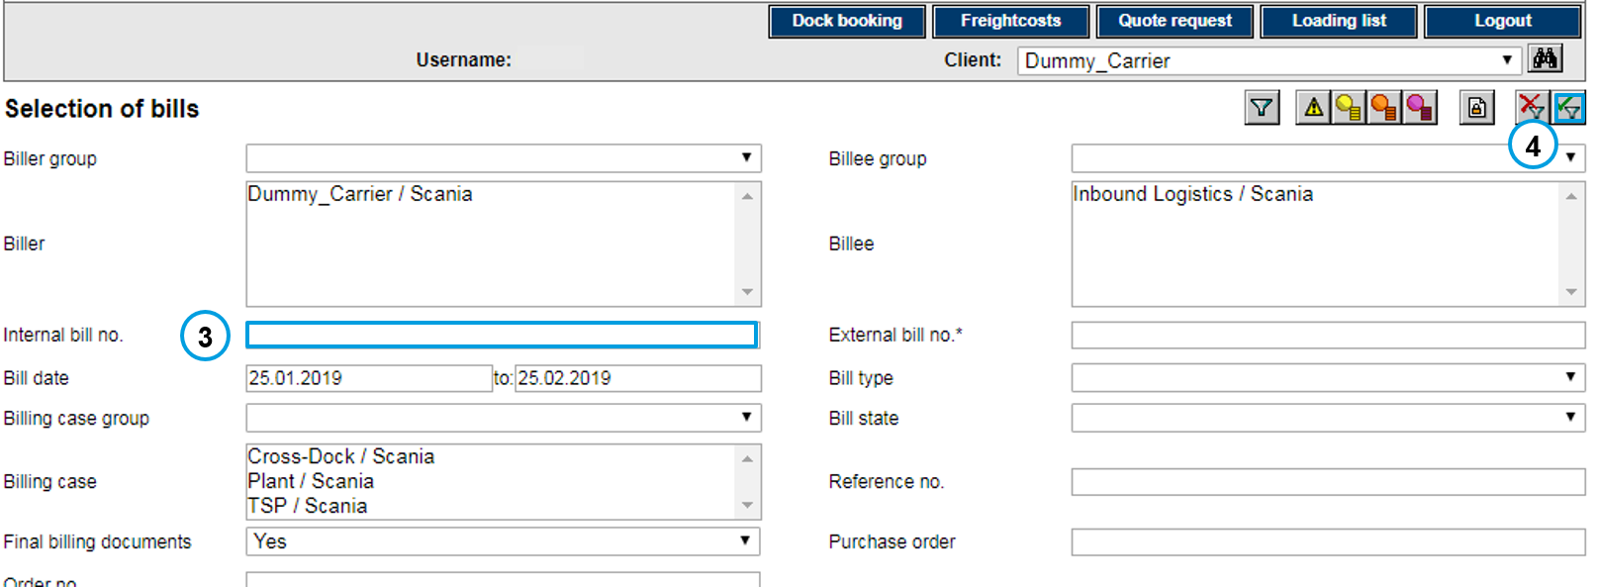
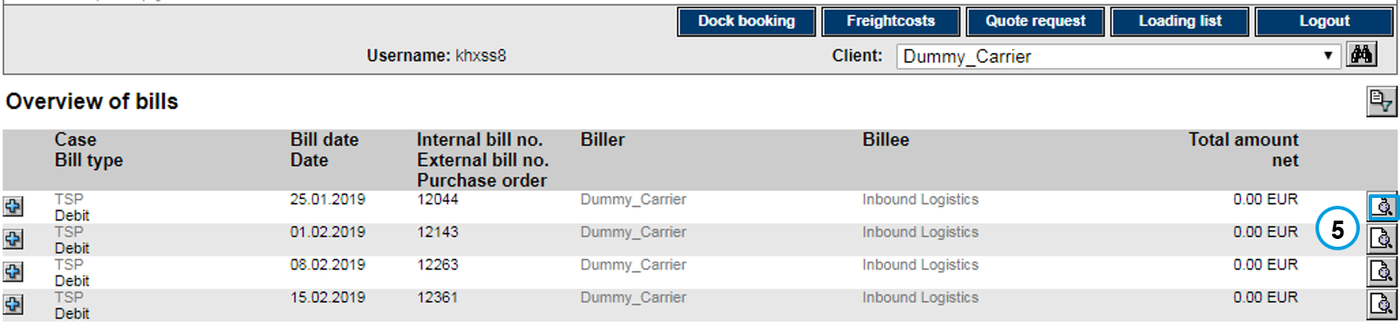
Print PDF invoices
Click on Freightcosts
Click the ”selection of bills” icon
Fill in ”Internal bill no.”
Click the ”execute selection” icon
Click the ”show bill” icon

Slide 6
Contact information
Pick-up country | Transport type | Contact email
SE, NO, DK, FI, PL, EE, LV, LT | Inbound | inbound.transport-nordic@scania.com
 | Packaging | packaging.transports-nordic@scania.com
NL, BE, DE, GB, IE, FR, ES, PT, LU, IT, AT, CH, CZ, HU, RO, SK | Inbound | inbound.transport-europe@scania.com
 | Packaging | packaging.transports-europe@scania.com
- | Components (all flows between Scania Production Units) | component.planning@scania.com

